Slide 1
The Cloud
CHAPTER 6 | The Cloud Part 1
The Cloud is the elastic leasing of pooled computer resources over the internet. The term cloud is used because most early diagrams of three-tier and other internet-based systems used a cloud symbol to represent the Internet and organizations came to view their infrastructure as being “somewhere in the cloud”.

Slide 2
“Why are organizations moving to the cloud?”
The client-server model appealed to organizations for its cost-effectiveness and scalability. Servers, costing thousands, were more affordable and easily scalable than million-dollar mainframes. This architecture allowed global access via the Internet, resembling early cloud concepts. While modern cloud computing emerged shortly after, some large organizations, like banks, still use mainframes for daily transactions.

Slide 3
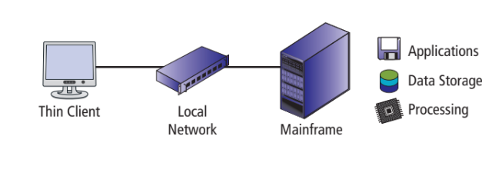
From the early 1960s to the late 1980s, organizations relied on mainframes for internal data processing. Mainframe architecture connected a central unit to thin clients (computer terminals) with screens, keyboards, and network connections. All processing, data, and applications were centralized on the mainframe. The absence of the modern cloud was due to the absence of the Internet during this period.
The Mainframe era (1960's-1980's)

Slide 4
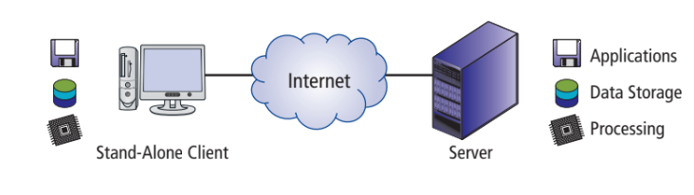
In the early '90s, as Internet usage surged, users connected personal computers to the Internet, and organizations adopted servers for web hosting. The client-server architecture facilitated users sending requests to servers across the Internet, with servers responding by sending data back. This allowed applications and data storage to be distributed between clients and servers, sharing processing load.
The Client-Server era (1990's-2000's)

Slide 5
Cloud Computing
Until around 2008, organizations managed their own computing infrastructure, acquiring and maintaining hardware on-premises for various purposes, including email, websites, e-commerce, and in-house applications. However, post-2008, there was a shift as organizations started migrating their computing infrastructure to the cloud.
Cloud computing enables remote access to organizational data and applications via various devices, eliminating the need for costly computing infrastructure. This shift mirrors the move to client-server architectures, driven by reduced costs and enhanced scalability.

Slide 6
Pooled
Elastic
The second key in the definition of the cloud is pooled. Cloud resources are pooled because many different organizations use the same physical hardware; they share that hardware through virtualization. Virtualization technology enables the rapid creation of new virtual machines.
The term elastic, which was first used this way by Amazon.com, means that leased computing resources can be increased or decreased dynamically, programmatically, in a short span of time and that organizations pay for only the resources they use.

Slide 7
Over the Internet
With the cloud, resources are accessed over the Internet, eliminating the need for local storage. This means organizations can do away with on-premises servers, associated costs like power, backup generators, extra space, climate control, and specialized fire suppression systems.

Slide 8
“Why do Organizations prefer the Cloud?”
Several factors have pushed organizations toward cloud-based hosting, including lower costs, ubiquitous access, improved scalability, and elasticity.
Not all organizations have fully embraced cloud computing. But the list of companies that have embraced cloud computing is growing rapidly. Well-known organizations like Netflix, Verizon, Disney, GE, and Comcast have all shifted to the cloud.
Cloud computing allows organizations to focus on their businesses, not spend time maintaining infrastructure. Organizations can outsource functions that are not their core competency and focus on those that give them a competitive advantage.

Slide 9
“When does the Cloud not make Sense?”
Cloud-based hosting makes sense for most organizations. The only organizations for which it may not make sense are those required by law or by industry standard practice to have physical control over their data.
A financial institution, for example, might be legally required to maintain physical control over its data. Even in this circumstance, however, it is possible to gain many of the benefits of cloud computing using private clouds and virtual private clouds.

Slide 10
“How do organizations use the cloud?”
Cloud-based platforms enable large enterprise businesses to build, test and deploy applications, and store, back up, and recover data.
Types of cloud-based platforms include:
Public cloud: Third-party providers that deliver computing resources over the internet for multiple businesses.

Slide 11
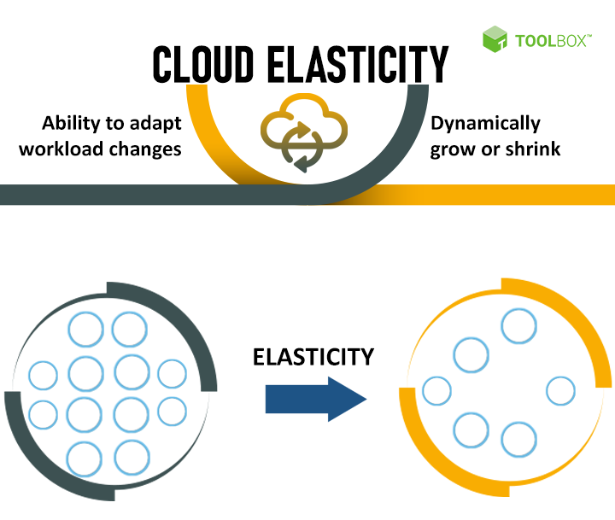
“What is Elastic Resources?”
Elastic resources are applications and infrastructure that can be summoned on demand when traffic or workloads get high.

Slide 12
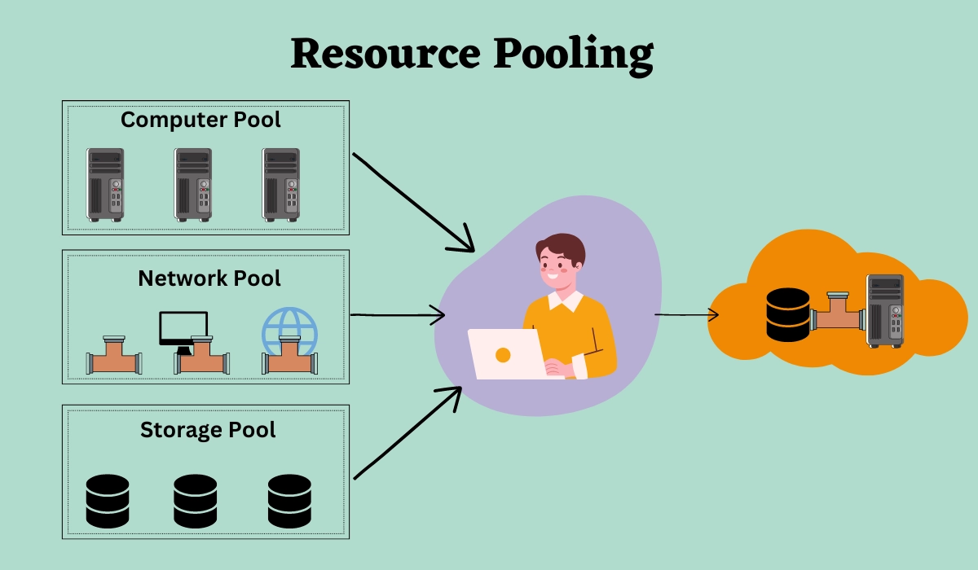
“Pooling resources”
Describe a situation in which providers serve multiple clients, customers or “tenants” with provisional and scalable services. These services can be adjusted to suit each client’s needs without any changes being apparent to the client or end user.

Slide 13
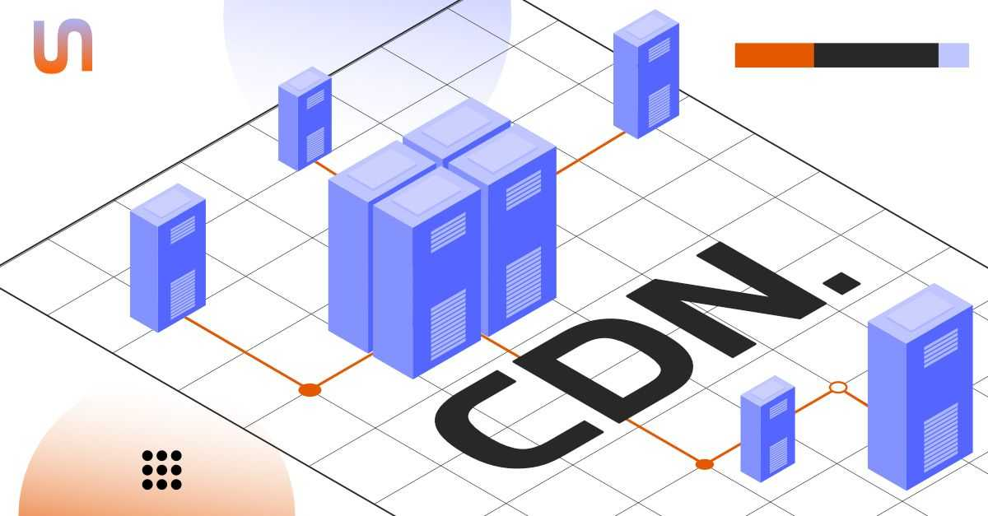
“Content delivery networks”
A content delivery network (CDN) is a system of hardware and software that stores user data in many different geographical locations and makes those data available on demand.

Slide 14
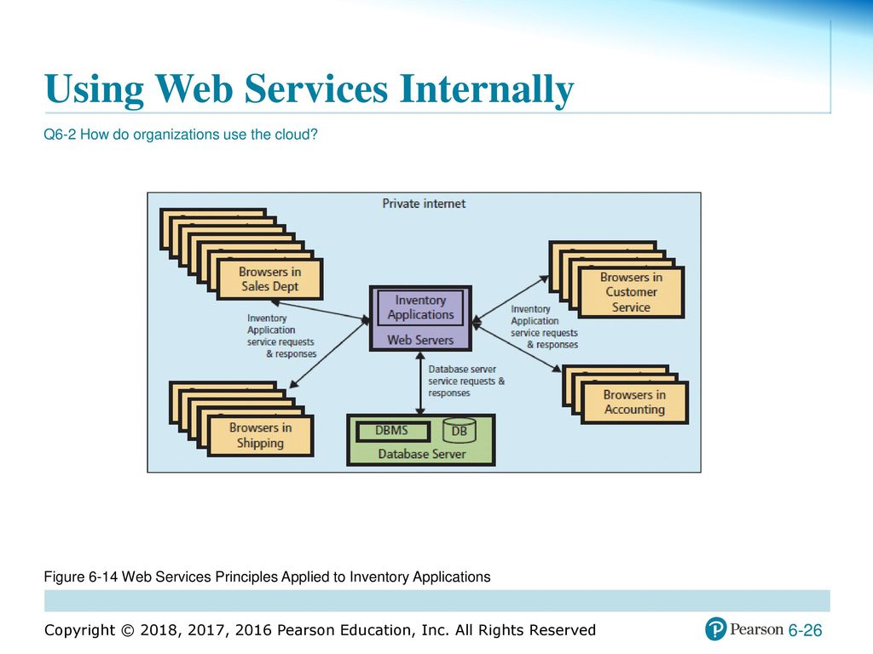
“Using the Web Services Internally”
The final way that organizations can use cloud technology is to build internal information systems using Web services.

Slide 15
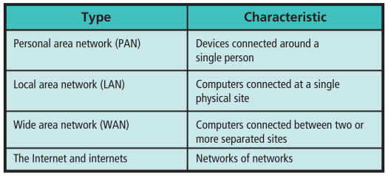
“What Network Technology supports the cloud?”
Figure 6-15

Slide 16
“What Network Technology supports the cloud?”
The internet is a network of networks. Internets connect LANs, WANs, and other internets. The most famous internet is “the Internet” (with an uppercase letter I), the collection of networks you use when you send email or access a Web site. In addition to the Internet, private networks of networks, called internets, also exist.
A private internet used exclusively within an organization is sometimes called an intranet.
The networks that make up the internet use a large variety of communication methods and conventions, and data must flow seamlessly across them. To provide seamless flow, an elaborate scheme called a layered protocol is used.
Protocol is a set of rules and data structures for organizing communication.

Slide 17
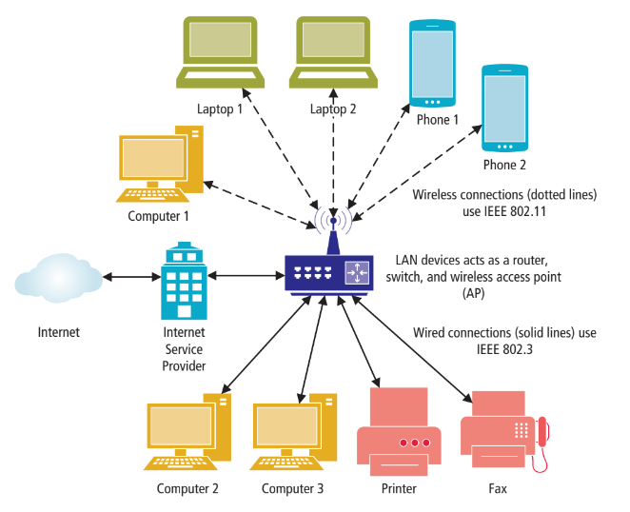
Components of LAN
Figure 6-16 shows a LAN typical of those in a small office or home office (SOHO).
The computers and printers communicate via a mixture of wired and wireless connections. Some devices use wired connections, and others use wireless connections. The devices and protocols used differ for wired and wireless connectivity.
Figure 6-16

Slide 18
The Institute for Electrical and Electronics Engineers (IEEE, pronounced “I triple E”) sponsors committees that create and publish protocols and other standards. The committee that addresses LAN standards is called the IEEE 802 Committee.
The IEEE 802.3 protocol is used for wired LAN connections. This protocol standard, also called Ethernet, specifies hardware characteristics, such as which wire carries which signals. It also describes how messages are to be packaged and processed for wired transmission over the LAN.
Wireless LAN connections use the IEEE 802.11 protocol. Several versions of 802.11 exist, and as of 2018, the most current one is IEEE 802.11ac. IEEE 802.11ac, allows speeds of up to 1.3 Gbps. The next version, 802.11ax, promises speeds around 10 Gbps.

Slide 19
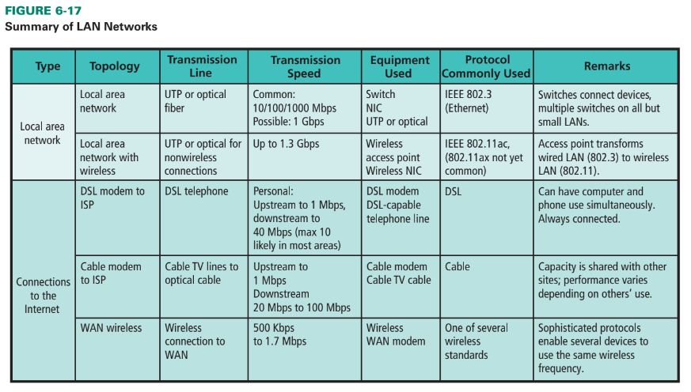
Connecting your LAN to the Internet
Figure 6-17 shows the three common alternatives for connecting to the Internet. Notice that we are discussing how your computer connects to the Internet via a WAN; we are not discussing the structure of the WAN itself. WAN architectures and their protocols are beyond the scope of this text.
Figure 6-17

Slide 20
A Digital subscriber line (DSL) operates on the same lines as voice telephones, but it operates so it does not interfere with voice telephone service. Because DSL signals do not interfere with telephone signals, DSL data transmission and telephone conversations can occur simultaneously.
A Cable line is the second type of WAN connection. Cable lines provide high-speed data transmission using cable television lines. The cable company installs a fast, high-capacity optical fiber cable to a distribution center in each neighborhood it serves.
WAN Wireless Connection. A third way you can connect your computer, mobile device, or other communicating device is via a WAN wireless connection.

Slide 21
“How Does the Internet Work?”
The cloud resides on the Internet. So, in order to learn how the cloud works, you need a basic understanding of how the Internet works.
The Internet and the U.S. Postal System
The Internet works much like the U.S. postal system in that both systems transport things from one location to another. The Internet transports email, while the U.S. postal system sends paper mail. Comparing the Internet to the U.S. postal system allows you to relate new Internet terms to a system with which you’re already familiar (the U.S. postal system).

Slide 22
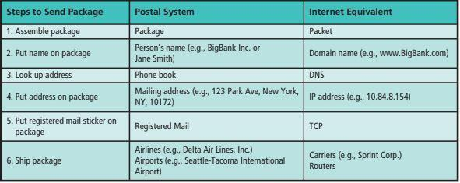
Comparison of the Postal System and the Internet

Slide 23
IP Addresses
DNS
Most people don’t remember addresses. It’s easier to remember a name like Jane Smith or Big-Bank Inc. and look up the mailing address in a phone book (or an Internet-based phone book).The Internet works the same way. Nobody wants to type IP addresses like http://165.193.140.14 to find a particular site. It is easier to enter names like www.pandora.com or www.woot.com or www .pearsonhighered.com.
IP AddressesIP addresses have two formats. The most common form, called IPv4, has a four-decimal dotted notation such as 137.190.8.10.a second format of IP addresses called IPv6 is being adopted—slowly. It has a longer format (e.g., 0:0:0:0:0:ffff:89be:80a), which accommodates 340 undecillion addresses.
Public IP addresses must be unique worldwide, their assignment is controlled by a centralized organization named ICANN (Internet Corporation for Assigned Names and Numbers).

Slide 24
Carriers
Net Neutrality
In the U.S. postal system, your package weaves its way toward its destination through multiple airports.
Large carriers exchange traffic without charging each other access fees via peering agreements. Carriers make revenue by collecting subscription fees from end users but not from peers.
Netflix, eBay, Yahoo!, and Amazon say that allowing carriers to charge these varying rates could hurt consumers and innovation. They believe in the net neutrality principle, where all data is treated equally. They argue that carriers should not be allowed to decide which sites load quickly, which apps are allowed on a network, and which content is acceptable.

